Slide 1

EDA LOAN STATUS PREDICTION
BY TEAM 17:
MONIKA K J
NANDITHA K N
SPOORTHY M N
NAVYA GADINA
NETHRAVATHI B

Slide 2
CONTENTS:
1.INTRODUCTION
2.EXISTING PROBLEM
3.PROPOSED SOLUTION
4.BLOCK DIAGRAM
5.DATA VISUALIZATION
6.RESULT
7.ADVANTAGES AND DISADVANTAGES
8.CONCLUSION

Slide 3

1.INTRODUCTION
There are huge number of phases in the prediction based on Machine Learning, and this prediction problem used most of them, Data collection is the first phase, by this phase data should be collected not usually a less data set, it should be huge data set according to the requirements one should collect or create the data for the prediction. Data Preprocessing is the second phase and this contain a lot of sub-phases for the processing of the data, it includes importing libraries, Data Visualization, Data Transformation, Feature Scaling, Splitting and Label Encoding. Data Splitting, in this phase the data is to be split into two as train_data and test_data for the training of the model. Then the Fourth phase is Model Training. Machine Learning techniques aid to distinguish between borrowers who pay back loans at the appointed time from those who don't. It also helps to expect when the borrower is at default, whether
providing loan to a particular customer will result in bad loans.
All processes related to banking sector could be analyzed using Machine Learning techniques to detect the customers behavior. It also helps to analyze whether the customer will make prompt or delay payment if the credit cards
are sold to them.

Slide 4

2. EXISTING PROBLEM
The previous models have high time complexity and space complexity whereas this model is constrained with the lot of advantages and with a higher accuracy than any other model already proposed. In this model we used Machine learning algorithm named logistic regression which give an accuracy more than 80% of the previously predicted problem and there is an user friendly user interface to check loan score for the people who are about get the loan, and lot of the previous models haven't included the UI (User interface) which is so friendly and convenient for the users..

Slide 5

3. PROPOSED SOLUTION:
MACHINE LEARNING(Logistic Regression):
Logistic regression is a classification algorithm, used when the value of the target variable is categorical in nature. It is most commonly used when the data in question has binary output, so when it belongs to one class or another. So we have used this model to build our application and we have created an UI using the Flask for the loan status prediction, this UI will allow the users to predict the loan status very easily and the User interface is user friendly not at least one complication in using the interface, and it can be used just by entering some necessary details into the UI in real time it'll give the predicted value like if the customer is beneficial to take a loan and how often does he pays the loan interest amount to the bank.

Slide 6
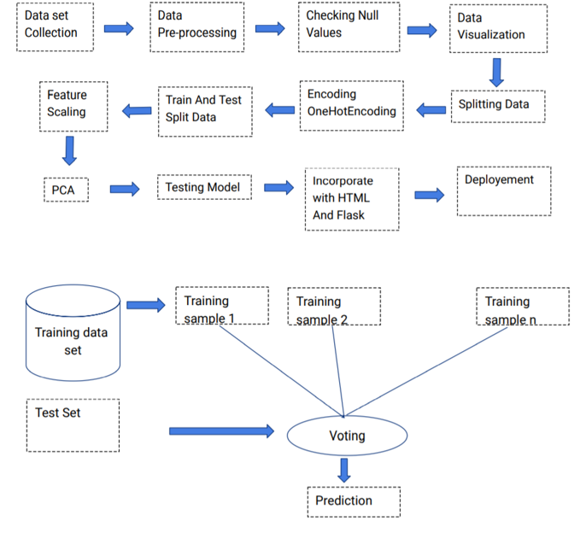
4.BLOCK DIAGRAM

Slide 7
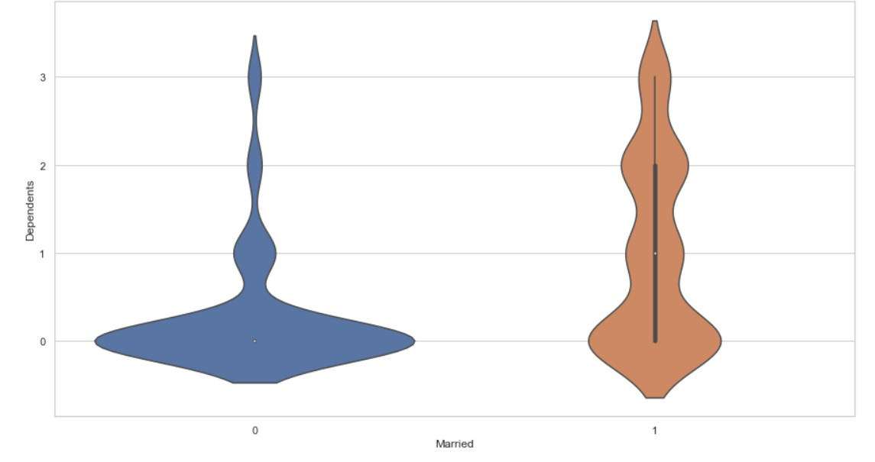
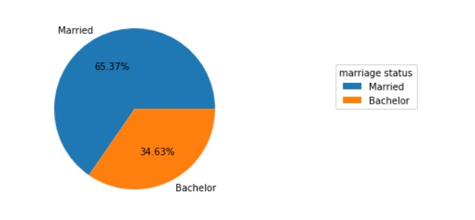
5.DATA VISUALIZATION: It is an important skill in applied statistics. This can be helpful when exploring and getting to know a dataset and can help with identifying patterns, corrupt data, outliers, and much more. And can be used to express and demonstrate key relationships in plots. Here we have used, histogram plots, bar charts, pie charts, violin plot and here are few examples.

Slide 8
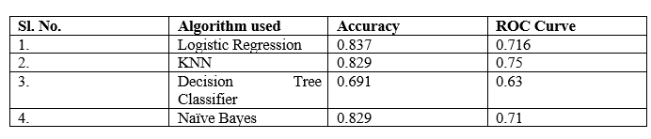
6.RESULT: In this paper, the Logistic regression algorithm is used to predict its performance, and compared with all other machine learning methods namely the decision tree, the Naïve Bayes, KNN, Random Forest. The obtained results are displayed in Table below. The results show that, the performance of logistic regression have comparable performance than that of Naive Bayes, KNN, random forest and decision tree, but the logistic regression still performs the best, with an accuracy of 83%, higher than the other models.

Slide 9

7. ADVANTAGES AND DISADVANTAGES Advantages: ● Easy and simple User Interface for the bank people who is going to evaluate the customer loan status. ● Logistic Regression give the accurate result of the prediction up to 83% which is the algorithm we used for prediction. ● It is composed using the HTML and Python for the web usage in real time. ● It can work in real time and predict as soon as the necessary details for prediction are given to the model. Disadvantages: ● It could not work anywhere like a web-application, if one is using other should be quiet. ● Needs more than a single value for the prediction.

Slide 10

8.CONCLUSION
In this paper, the logistic algorithm is adopted to build a UI model for predicting loan status and the results are compared with other algorithms of Naïve Bayes, KNN, random forest and decision tree. The experiment shows that the logistic regression algorithm performs outstanding than the other algorithms in the prediction of loan default and has strong ability of generalization. There is no definitive guide of which algorithms to use given any situation. What may work on some data sets may not necessarily work on others. Therefore, always evaluate methods using cross validation to get a reliable estimates.

Slide 11

THANK YOU

